Slide 1

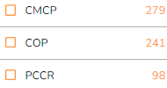
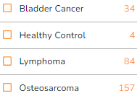
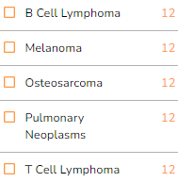
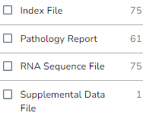

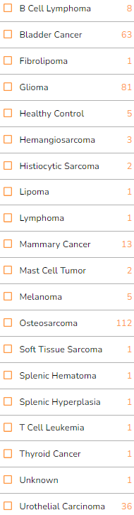

update: 230629
Program
Clinical Trial
Transcriptomics
File Type
.bai
.doc, .pdf, .rtf, .tif
.bam
Study type
Merged read counts
Genomics
download File Manifest from ICGC
upload this file in CGC
get file download link

Slide 2
